Slide 1
KENNY HILLS BAKERS EMPLOYEES TRAINING PRESENTATION
Manreen Kaur ​A/P Jagjit Singh - TP071290
Nesya Dinasarah Napitupulu - TP070035

Slide 2
INTRODUCTION
Kenny Hills Bakers is a bakery that sells high-quality baked goods and baking supplies, as well as handy, easy-to-use baking utensils.
It is mostly known for its pastries and baking supplies, such as flour.
The ingredients used to create the baking supplies and baked goods are sourced from the most-trusted farms that maintain their quality control to produce satisfactory results for customers.
The baking utensils are created using user-friendly materials to guarantee safety for customers when being used.

Slide 3



CONGRATULATIONS AND WELCOME ABOARD!
I am delighted to announce that our new employees are going to learn how to use Microsoft 365. The reason why employees are required to go through this training is because employees needs to learn how to use the spreadsheet and learn how to make sure their work progress runs smoothly and efficiently. My business partner and I are occupied therefore we are unable to make monthly review and insert data information to improve for upcoming months.

Slide 4
Main Menu
Walkthrough
Function and Formulas
Table and Charts

Slide 5




SPREADSHEET'S OVERVIEW
INVENTORY SHEET
SALES SHEET
EMPLOYEE SALARY SHEET
ANALYSIS SHEET
8 CATEGORIES OF PRODUCTS
EACH PRODUCTS HAS ITS OWN PRODUCT NAME
PRODUCT ID
A SHORT DESCRIPTION ABOUT THE PRODUCTS
COST OF EACH PRODUCT
SELLING PRICE OF THE PRODUCT
NUMBER OF PRODUCT SOLD
NUMBER OF PRODUCT NOT SOLD
PRODUCT CATEGORIES
BRAND NAMES
MODEL NAMES
PRODUCT ID
SELLING PRICE OF EACH PRODUCTS
NUMBER OF ITEMS SOLD
SALES AGENT NAME
REVENUE
TOTAL REVENUE
EMPLOYEE'S ID
EMPLOYEE'S NAME
EMPLOYEE'S POSITION
EMPLOYEE'S CONTACT NUMBER
EMPLOYEE'S AGE
EMPLOYEE'S ADDRESS
EMPLOYEE'S SALARY
SALES REVENUE
UTENSILS COMMISSION
BAKING SUPPLIES COMMISSION
BONUS COMMISSION
PIVOT TABLE FOR INVENTORY,SALES AND EMPLOYEE'S SALARY
CHARTS FOR INVENTORY,SALES AMD EMPLOYEE'S SALARY

Slide 6
PURPOSE OF USING SPREADSHEET
Easy way of storing all different kind of data (financial data, bakery business data et cetera).
Able to store huge amount of data and ideal for database storage.
Has formula’s that can calculate profit that allows company to manage income and expenditures.
Able to identify inaccuracies and duplicates in your data.
Able to generate charts and reports that allows easier analysis of data.

Slide 7
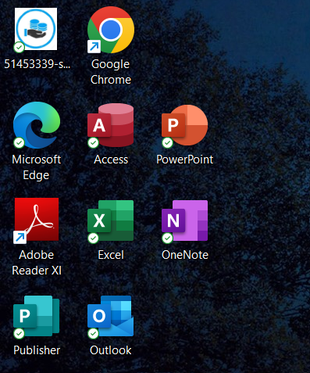
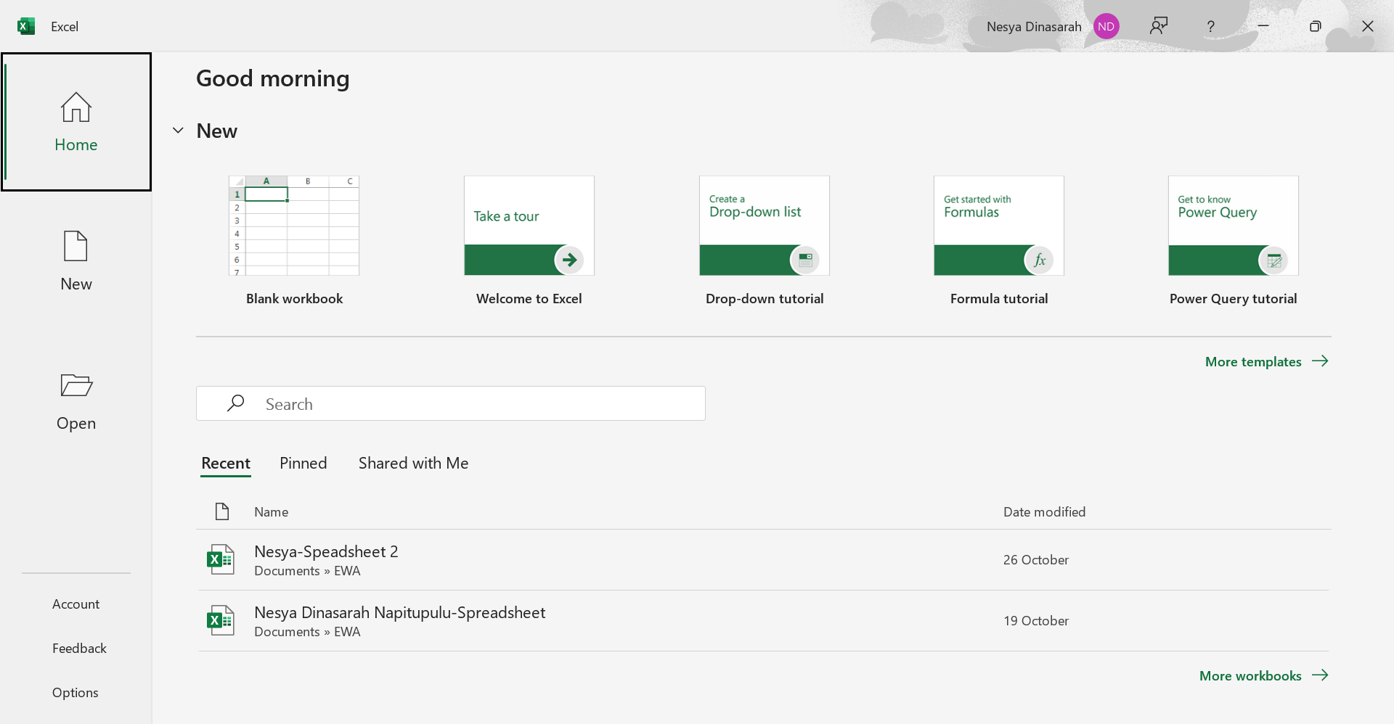
WALKTHROUGH OF SPREADSHEET
1. Launch Excel from your device
2. Click “Blank Workbook” to create a new spreadsheet

Slide 8
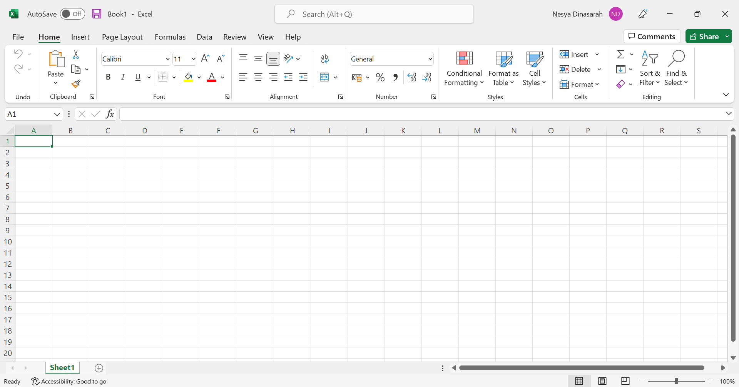
WALKTHROUGH OF SPREADSHEET
3. Blank Excel Spreadsheet is created.

Slide 9
WALKTHROUGH OF SPREADSHEET
4. Able to add on more sheets in one spreadsheet.

Slide 10
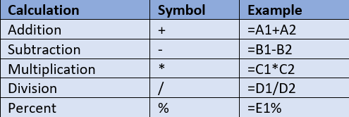
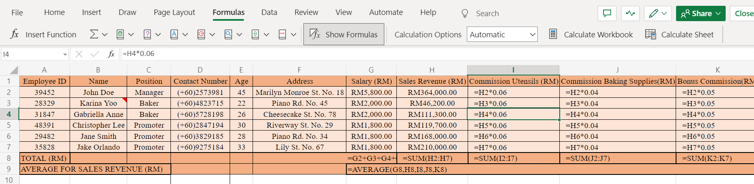
FORMULAS
1. FORMULAS CALCULATION IN SPREADSHEET
2. HOW TO INSERT FORMULAS IN SHEETS

Slide 11



FORMULAS - CONTINUATION
WHAT ARE FORMULAS FOR?
WHAT IS FORMULA USED FOR?
WHAT DOES EACH FORMULA CALCULATE?
Addition: To add up all the data
Subtraction: To find the difference between values
Multiplication: To find the product of the value(s) times quantity
Division: To divide the value(s) per quantity
Percent: To obtain the data per 100
Addition: To simplify adding up values without typing the numbers
Subtraction: To simplify
Multiplication: To multiply the chosen data directly with the desired quantity
Division: To divide the chosen data directly with the desired quantity
Percent: To obtain the data's percentage without further calculations
Addition: Salaries of all workers, total quantities sold/unsold
Subtraction: Profit
Multiplication: Total sales revenue of each item, bonus, commission
Division: Average cost of each product
Percent: Percentage of bonus/commission

Slide 12
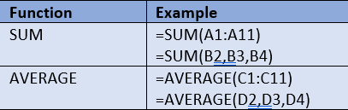
FUNCTIONS
1. FUNCTIONS CALCULATION IN SPREADSHEET
2. HOW TO INSERT FUNCTIONS IN SPREADSHEET

Slide 13
FUNCTIONS - CONTINUATION
WHAT ARE FUNCTIONS FOR?
WHAT IS FUNCTIONS USED FOR?
WHAT DOES EACH FUNCTION CALCULATE?
SUM: To add up large quantities of data
AVERAGE: To find the mean of each data that has been summed up
SUM: To simplify addition of large quantities of data
AVERAGE: To distribute the average easily without extra calculations
SUM: Total revenue of all products
AVERAGE: Average salary, average sales revenue

Slide 14
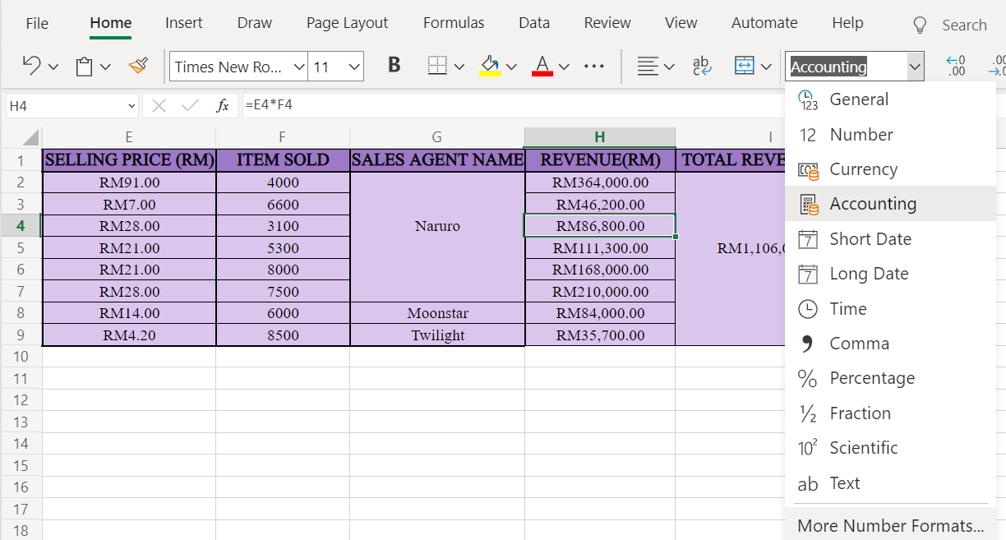
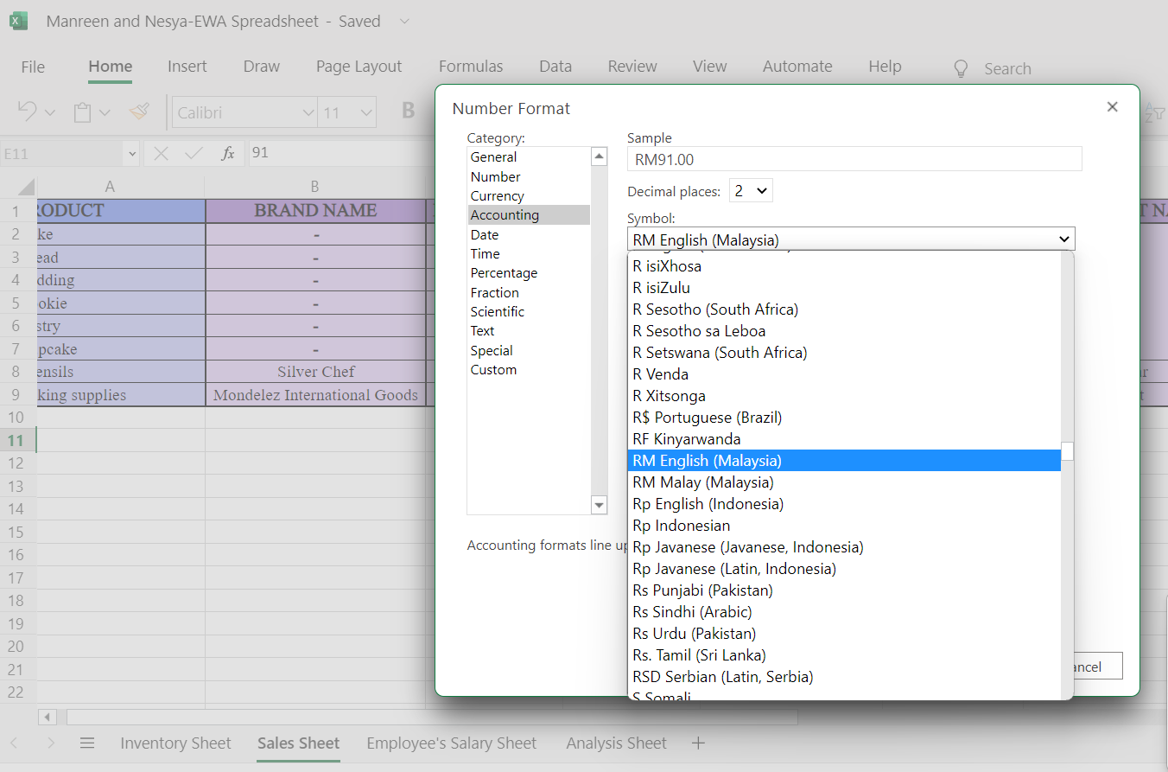
NUMBERS FORMAT
1. HOW TO APPLY NUMBERS FORMAT IN SPREADSHEET:
FROM HOME, CLICK ON GENERAL
CHOOSE ACCOUNTING OR CURRENCY
2. HOW TO APPLY CURRENCY FOR NUMBER FORMAT:
GO TO MORE NUMBER FORMAT POP-UP CHOOSE ACCOUNTING
CLICK ON THE SYMBOL DROPDOWN TO CHOOSE “RM ENGLISH (MALAYSIA)”

Slide 15
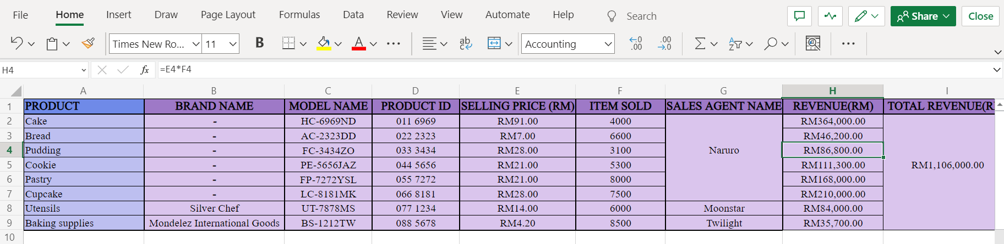
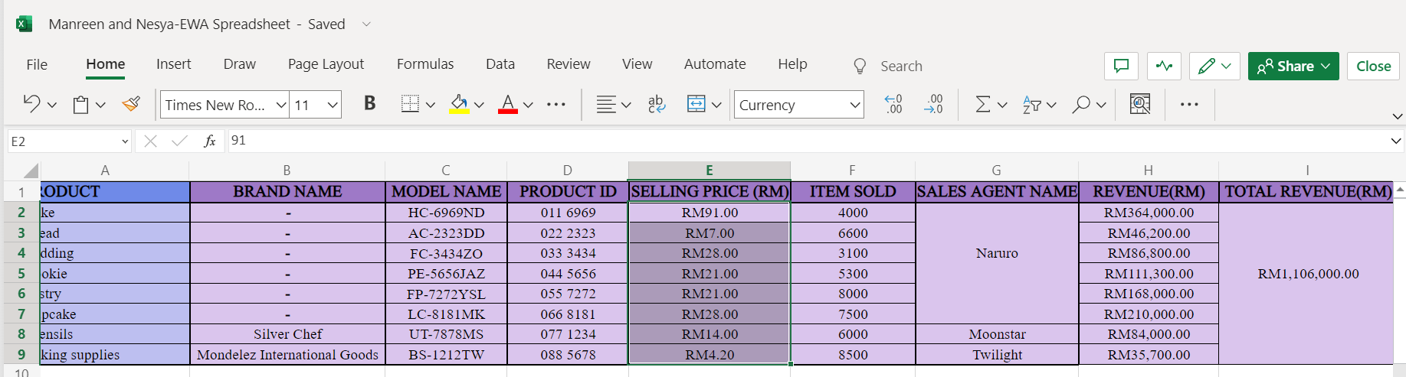
NUMBERS FORMAT
1. ACCOUNTING MYR CAN BE SEEN AS IN SCREENSHOT BELOW:
2. CURRENCY MYR CAN BE SEEN AS IN SCREENSHOT BELOW:

Slide 16
WHAT IS PIVOT TABLE?
WHAT ARE THEY FOR?
A powerful tool that can be used to calculate, summarize and analyse data that can be viewed in patterns, trends and comparison of data.
Helps to make informed decisions about crucial data in an organization.
WHAT CAN BE DONE WITH PIVOT TABLE?
Query large amount of data in user-friendly way.
Able to summarize data by categories and subcategories with custom calculations and formulas creation.

Slide 17
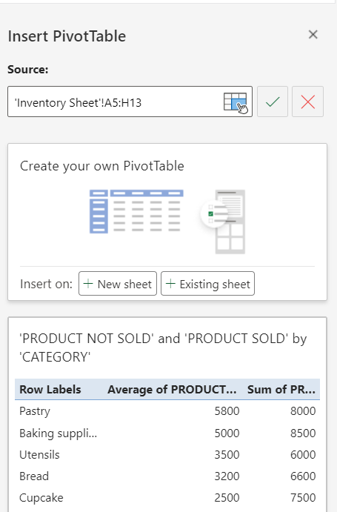
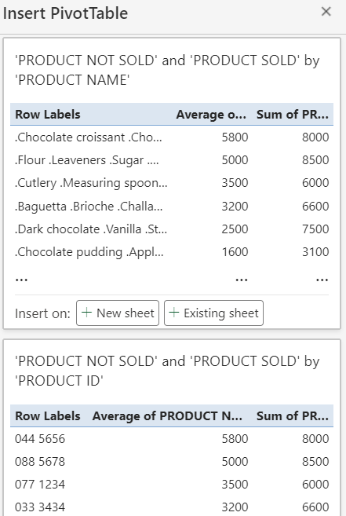
HOW TO CREATE PIVOT TABLE?
1. PIVOT TABLE CAN BE FOUND UNDER INSERT TAB:
CLICK PIVOT TABLE
SELECT TABLE FROM SPREADSHEET
2. INSERT PIVOT TABLE CAN BE DONE AS FOLLOWS:
SELECT COLUMNS AND ROWS TO CREATE PIVOT TABLE
DATA WILL BE SHOWN BASED ON CATEGORIES AND USER ABLE TO SELECT FILTERS
CLICK ON EXISTING SHEET

Slide 18
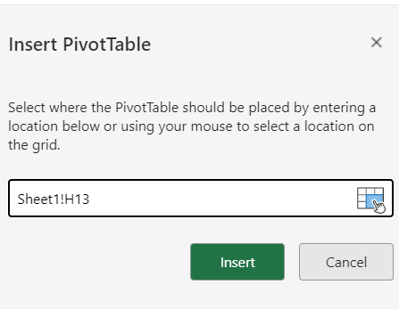
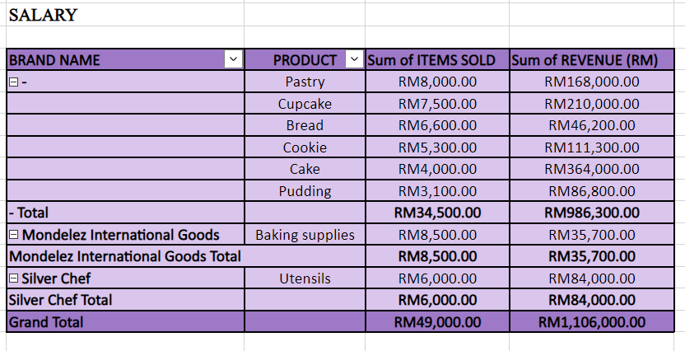
HOW TO CREATE PIVOT TABLE?
ADD PIVOT TABLE TO SHEET:
ONCE CATEGORIES HAS BEEN CHOSEN, CLICK ON INSERT
2. PIVOT TABLE HAS BEEN CREATED SUCCESSFULLY

Slide 19
WHAT IS CHARTS?
WHAT ARE THEY FOR?
To create a graphical representation of any set of data.
Data can be represented by symbols such as bars in bar chart or lines in a line chart.
Charts can be understood quicker than raw data.
WHAT IS DATA CHART?
A type of diagram or graph, that organizes and represents a set of numerical or qualitative data.
Used to ease understanding of large quantities of data and relationship between parts of data.

Slide 20
WHAT IS COLUMN/BAR CHARTS?
WHAT IS PURPOSE OF BAR CHART?
CONVEYS RELATIONAL INFORMATION QUICKLY IN A VISUAL MANNER.
WHAT IS BAR CHART?
DISPLAYS DATA USING NUMBER OF BARS THAT REPRESENTS A PARTICULAR CATEGORY.
BAR GRAPHS HAS X-AXIS AND Y-AXIS THAT CAN BE USED TO COMPARE ONE OR MORE CATEGORIES OF DATA.
IT CAN ALSO BE GROUPED TOGETHER FOR COMPARATIVE PURPOSES.
WHAT ARE THE BENEFITS OF BAR CHART?
EASIER TO EXPLAIN COMPLEX DATA.
ALLOWS TO COMPARE DIFFERENT SETS OF DATA AMONG DIFFERENT GROUPS EASILY.
ABLE TO ILLUSTRATE CHANGES IN DATA THROUGHOUT A PERIOD OF TIME.

Slide 21
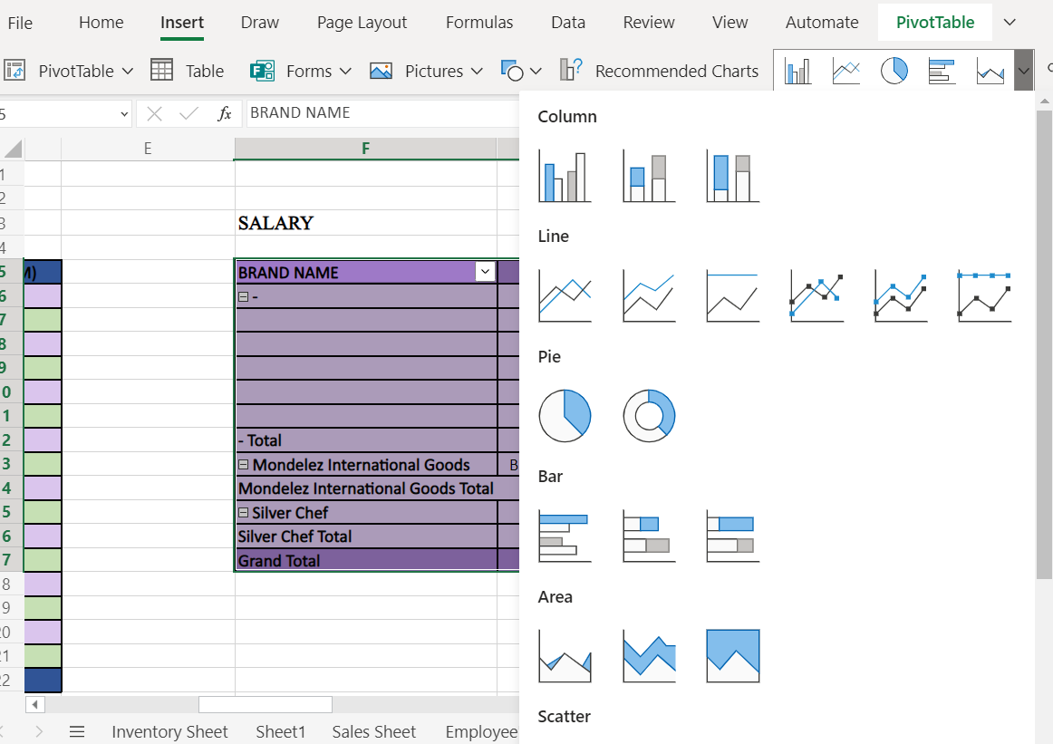
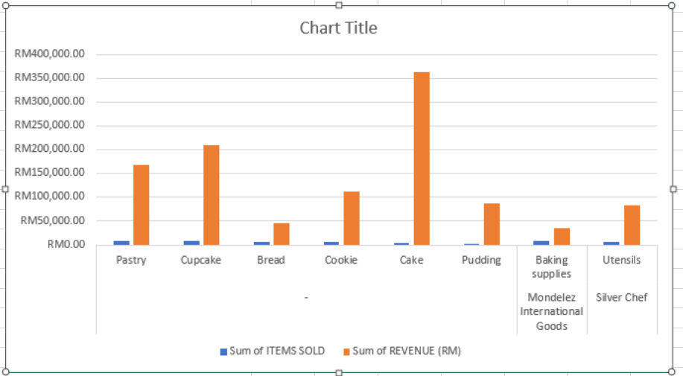
HOW TO CREATE COLUMN/BAR CHARTS?
1. COLUMN CHARTS CAN BE FOUND UNDER INSERT TAB:
SELECT TABLE, CLICK ON RECOMMENDED CHARTS DROPDOWN
CHOOSE A DESIRED COLUMN CHART TYPE
2. CHART WILL BE ADDED INTO SAME SPREADSHEET AUTOMATICALLY

Slide 22
WHAT IS PIE CHARTS?
WHAT IS PURPOSE OF PIE CHART?
DISPLAYS PERCENTAGE OF A WHOLE AND REPRESENT PERCENTAGES AT A SET POINT IN TIME.
WHAT IS PIE CHART?
A TYPE OF GRAPH THAT DISPLAYS DATA IN A CIRCULAR GRAPH.
ABLE TO GIVE SNAPSHOT OF HOW A GROUP IS BROKEN DOWN INTO SMALLER PIECES.
WHAT ARE THE BENEFITS OF BAR CHART?
EFFECTIVE COMMUNICATION TOOL AS IT REPRESENTS DATA VISUALLY AS A FRACTIONAL PART OF A WHOLE.
ALLOWS DATA COMPARISON THAT MAKES AN IMMEDIATE ANALYSIS OR UNDERSTAND INFORMATION QUICKLY.

Slide 23
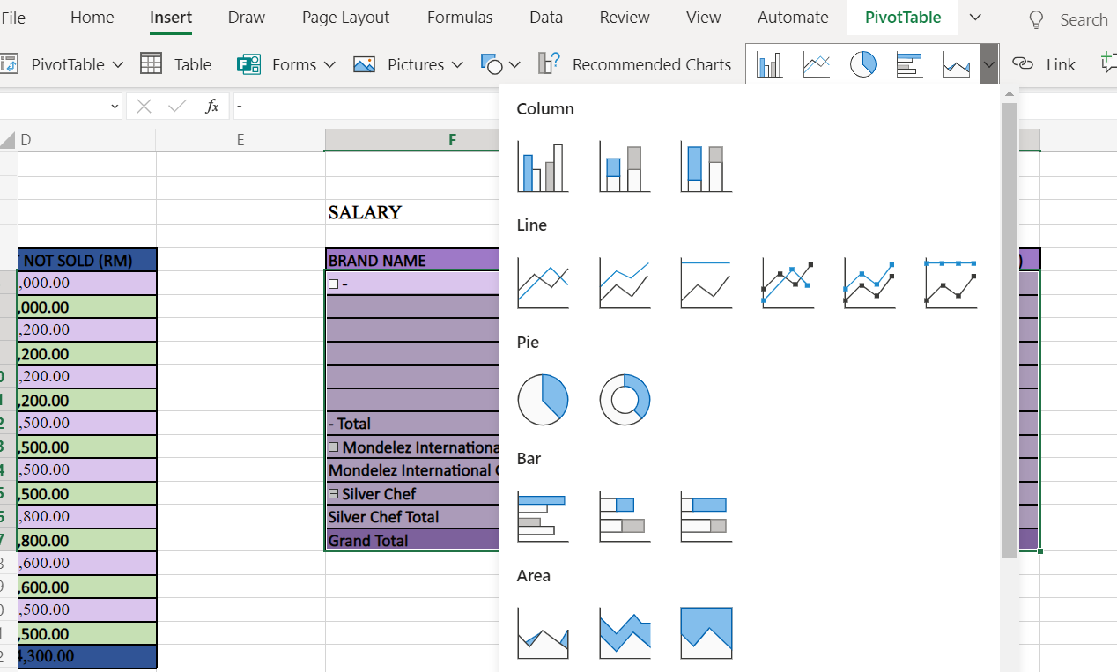
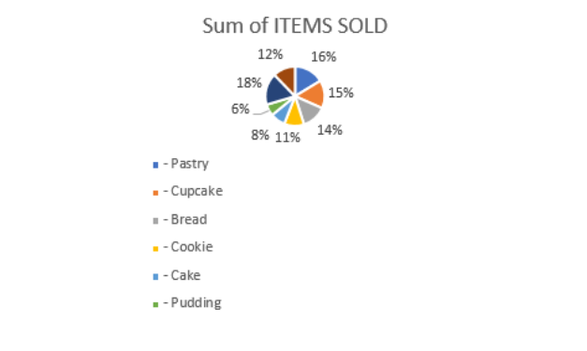
HOW TO CREATE PIE CHARTS?
1. PIE CHARTS CAN BE FOUND UNDER INSERT TAB:
SELECT TABLE, CLICK ON RECOMMENDED CHARTS DROPDOWN
CHOOSE A PIE CHART
2. PIE CHART WILL BE ADDED INTO SAME SPREADSHEET AUTOMATICALLY

Slide 24
WHAT IS LINE CHARTS?
WHAT IS PURPOSE OF LINE CHARTS?
DISPLAYS QUANTITATIVE VALUES OVER A SPECIFIED TIME INTERVAL.
DEPICT THE HISTORICAL PRICE ACTION OF AN ASSET OR SECURITY.
WHAT IS LINE CHARTS?
A TYPE OF GRAPH THAT UTILIZES POINTS AND LINES TO REPRESENT CHANGE OVER TIME.
LINE JOINING SEVERAL POINTS OR LINE THAT SHOWS THE RELATION BETWEEN THE POINTS.
WHAT ARE THE BENEFITS OF LINE CHARTS?
DATA THAT VISUALLY REPRESENTS THE RATE COMPREHENSIVELY .
COMPETENT TO MAKE FUTURE’S PREDICTIONS ABOUT THE RESULTS OF DATA HAVE NOT BEEN RECORDED.

Slide 25
HOW TO CREATE LINE CHARTS?
LINE CHARTS CAN BE FOUND UNDER INSERT TAB:
SELECT TABLE, CLICK ON RECOMMENDED CHARTS DROPDOWN
CHOOSE A LINE CHART
2. LINE CHART WILL BE ADDED INTO SAME SPREADSHEET AUTOMATICALLY

Slide 26
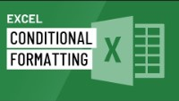
FOR MORE GUIDANCE
1. EXCEL CONDITIONAL FORMATTING
2. EXCEL SPREADSHEET EXAMPLE

Slide 27
CONCLUSION
Generate and sustain the company’s spreadsheet
Manufacturing explicit data into spreadsheet
Innovative design
Microsoft Teams Video Training

